Slide 1
Contextual Intelligence at the Point of Action
Medical Customer Engagement
Addressing the MSL need to feel confident in discussions with KOLs; presenting a medical affairs acumen and supporting evidence with credibility.
Notes:
Newest ZAIDYN product to launch

Slide 2

Melissa – Medical Science Liaison
Acting as a long-term medical partner responsible for planning, executing, and following up on medical engagements; activities such as congresses, advisory boards, medical education, medical inquiries, and evidence generation with KOLs.
Works under time pressure, strict compliance, and with information spread across CRM and other systems.
Core Job Description
When managing ongoing medical engagements, I want to improve scientific exchange and influence HCP behavior, so I can contribute to better patient outcomes.
Emotional Job Description
When making medical decisions across engagements, I want to feel confident that my judgement and actions are evidence backed and compliant, so I can act with credibility and stand behind my impact.
Notes:
Be sure to speak often about the MSL behaviors
Medical doctors, scholars, researchers, absorbers of knowledge

Slide 3
Medical Customer Engagement
Innovates the way users work with an assistant like product
Workflows multimodal
Flexible in a way users think, behave, and act
Making Melissa more productive through efficiency gains
Notes:
A theme of all of these North Star visions
Innovates the way users work with an assistant like product. Workflows in the product are no longer one dimensional, rather multimodal, making the product flexible in a way users think, behave, and act.
All of this adds to the current value prop of MCE by making Melissa more productive through efficiency gains, better time management of tasks, and increased engagement of the product through trust and stickiness.
To achieve this, I’ll highlight the agentic experience for the MSL which is contextually on 3 fronts:
Who The system knows the user and learns the user’s behaviors, patterns, and approaches
Where The system knows where the user is in the application and can interpret what the user is intending to do
Outcomes The system is task oriented based upon the user’s behavior to assist in successful completing objectives
Callout that the intelligence doesn’t complete with one another (left / right)

Slide 4
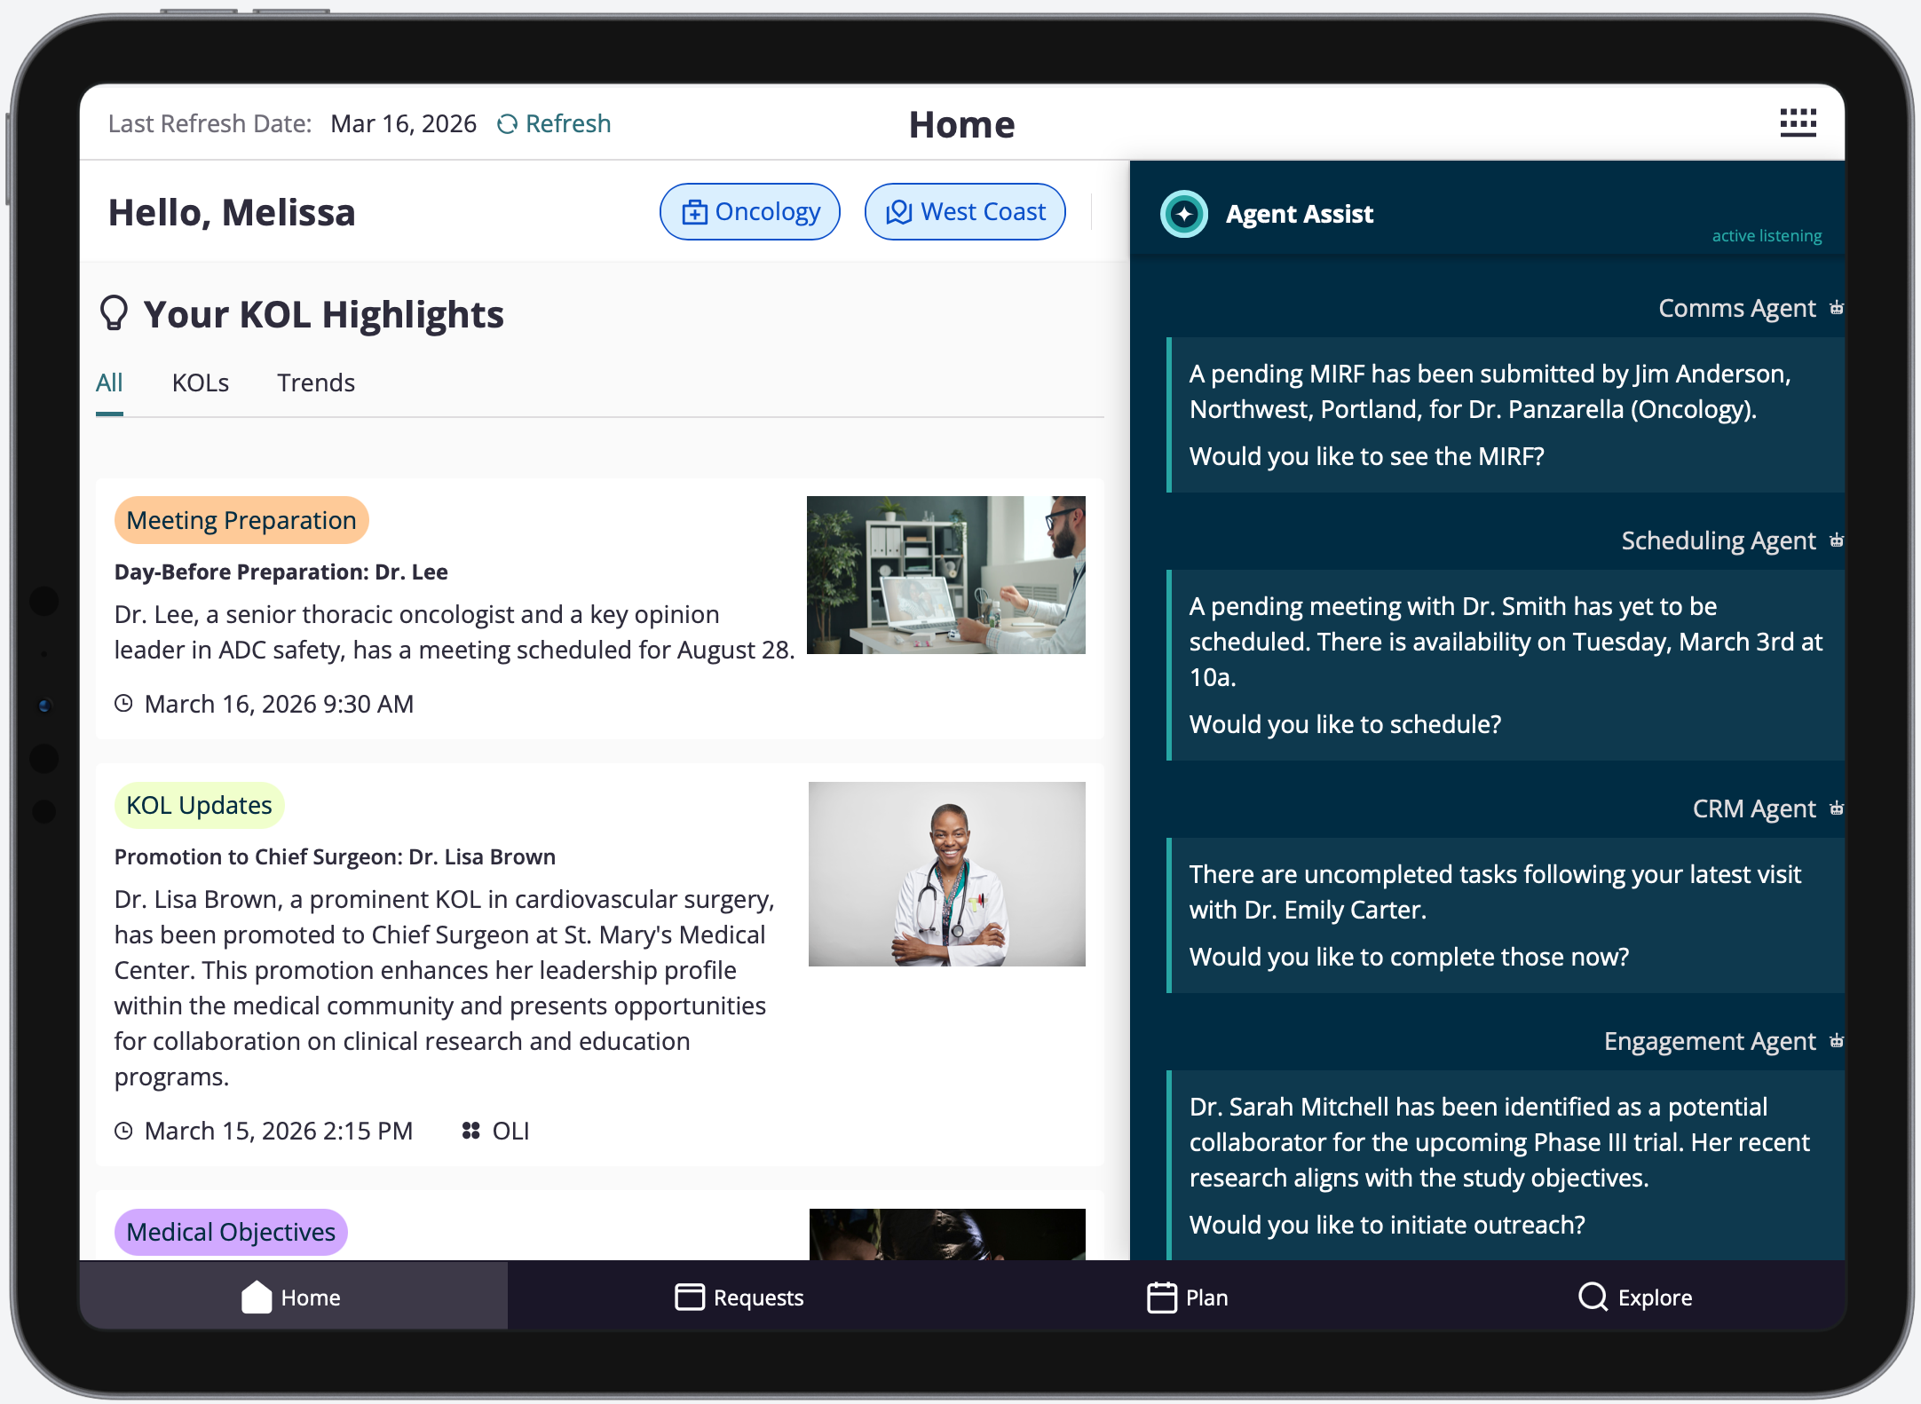
Mce north star experience

Slide 5
is a product assistant that is: contextually aware of who the user is contextually aware of where the user is contextually aware of the outcomes set by the user while keeping the user at the epicenter
Mce north star experience
MCE North Star prototype
Notes:
Who The system knows the user and learns the user’s behaviors, patterns, and approaches
Where The system knows where the user is in the application and can interpret what the user is intending to do
Outcomes The system is task oriented based upon the user’s behavior to assist in successful completed objectives

